Slide 1
New Year, New Platform: Let’s Make Sure it Works
Focus on ORPP&E Resources for the Field
Dial in (Main): (404) 397-1596
Attendee Access Code: 199-846-7461
Slides available on SharePoint:
See link in Chat box
Soundia Duche, MA, MS
Director, Education & Training
ORPP&E
February 2, 2021

Slide 2
Objectives
Dial in (Main): (404) 397-1596
Attendee Access Code: 199-846-7461
Slides available on SharePoint:
See link in Chat box
Test functionality of ORPP&E’s new platform for national webinars, WebEx Events.
Highlight ORPP&E’s key education and training initiatives in 2020.
Review ORD’s searchable FAQ database by discussing:
  How it was developed
  What it contains
  How the search methodology functions

Slide 3
Our Mission
Dial in (Main): (404) 397-1596
Attendee Access Code: 199-846-7461
Slides available on SharePoint:
See link in Chat box
ORPP&E is responsible for: all policy development and guidance for human research protection in the VA; all training and education in human research protection throughout the VA; and creating and implementing the VA Central IRB.

Slide 4
Education and Training: Key Initiatives in 2020
Created novel ways to disseminate information to the field
Consolidated all Human Subjects Information on one webpage: ORD Human Research Policy and Guidance Page
Created three toolkits that compile all information pertaining to a topic in one place
  Exempt Research
  R&D Committee Review
  Information Security Review
Developed Searchable FAQs

Slide 5
Poll 1: Policy and Guidance Webpage
How often do you use ORD’s Human Research Policy and Guidance Webpage?
  Seldomly
  Occasionally
  Frequently
  This is my first time hearing about ORD’s Human Research Policy and Guidance Webpage.

Slide 6
Poll 2: ORPP&E Toolkits
2. Have you used any of ORPP&E’s Research Toolkits? (select all that apply)
  Not yet
  Yes, the Exempt Research Toolkit
  Yes, the R&D Committee Toolkit
  Yes, the Research Information Security & Cybersecurity Toolkit
  This is my first time hearing about Research Toolkits

Slide 7
Poll 3: ORD Searchable FAQs
How often do you use ORD’s Searchable FAQs?
  Seldomly
  Occasionally
  Frequently
  This is my first time hearing about Searchable FAQs.
2. What have you found most challenging about the searchable FAQs?
ORD Human Guidance and Policy Webpage
ORPP&E Toolkits
ORD’s Searchable FAQs

Slide 8


Sending Questions to Individual ORPP&E Staff

Slide 9
Mailboxes Managed by ORPP&E
Name of Mailbox | Address | Purpose
COVID-19 Expanded Access Coordinator Mailbox | covidexpandedcoord@va.gov | Query box for VA research study coordinators to send issues/questions about expanded access activities under FDA oversight for investigational therapies for COVID-19
ORD COVID-19 Regulatory mailbox | ORDCOVIDresearchregulatory@va.gov | Regulatory box for any VA research office or researchers/study team members to send regulatory queries regarding VA COVID-19 human subject research activities
IRB Reliance and Single IRB Exception Request Mailbox | IRBRelianceandSIRBExceptions@va.gov | Mailbox for VA Facility’s to submit requests for (1) Exceptions from the Single IRB Requirement/Cooperative Research Provision; (2) changes in IRB arrangements (e.g. Commercial or non-Commercial IRB reliance); and (3) questions pertaining to the aforementioned
VAIRRS Mailbox | VAIRRS@VA.gov | Program mailbox for study teams, administrators, and research office staff to send questions related to the VAIRRS Program.
ORD Regulatory Mailbox | vhacoordregulatory@va.gov | Regulatory box for any VA research office or researchers/study teams to send regulatory queries regarding ORD policy (primarily pertaining to human subjects research)

Slide 10
ORD Regulatory Mailbox Database
In 2019, ORPP&E created a database to better track and analyze questions received from the field.
2019: Responded to 242 questions sent to the Regulatory Mailbox.
Through October 31, 2020: Responded to 416 questions sent to the Regulatory Mailbox.
2019 Top Topics | 2020 Top Topics
Exempt (34) | Informed Consent (64)
R&D Committee (32) | Recruitment (29)
Informed Consent (27) | R&D Committee (19)
Recruitment (11) | HRPP (23)
Transition to 2018 Requirements (10) | Exempt (18)
Agreements (9) | Agreements/Cooperative Research Provision (17 each)

Slide 11
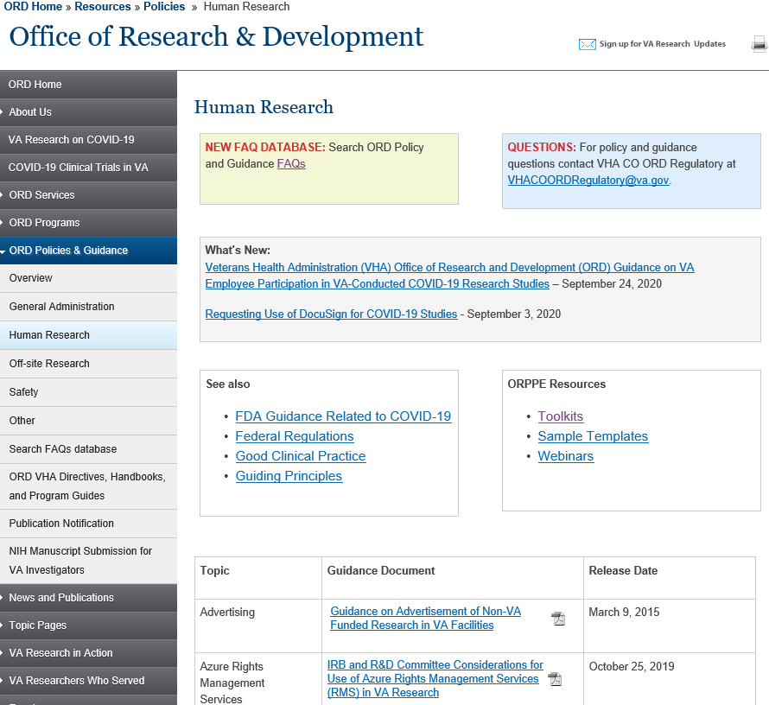
ORD Regulatory Mailbox Database v2.0
In September 2020, ORD’s regulatory mailbox database was updated to be able to also capture published FAQs found on the ORD Human Subject Policy and Guidance webpage.
Approximately 200 ORD FAQs were released on October 1, 2020.
An additional 150 FAQs contained in ORD guidance documents were released on December 15, 2020.

Slide 12
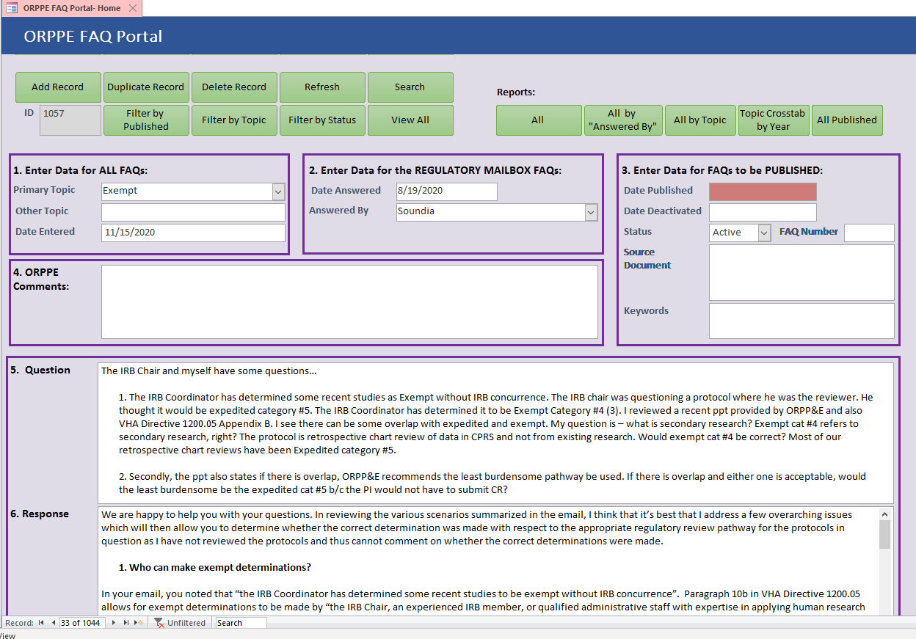
ORD Regulatory Mailbox/Searchable FAQ Database

Slide 13
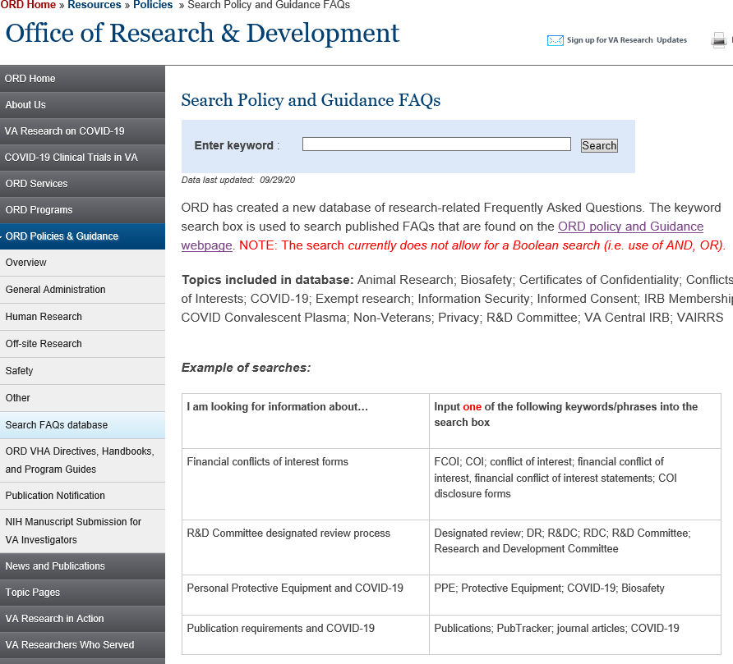
Searchable FAQs
Can be found here: https://www.research.va.gov/resources/policies/faq-search.cfm or can be accessed from the Human Research Policy and Guidance webpage.
342 records are included in the searchable FAQ database (as of 12/31/2020).
Search methodology is based on matching key words used to tag each entry.
Search methodology allows for use of the Boolean search operator “AND”.

Slide 14
Getting a Hit/Multiple Hits from your Search
Multiple key words and phrases are used to tag each entry.
A “hit” occurs when the word entered into the search box matches all of or a part of a key word or phrase included in the database.
If the word entered into the search box does not match one of the key words used to tag the FAQ, you will not get a hit. For example:
  If the search term is misspelled, you will not get a hit;
  If the plural form of the word is used as a search term when the singular form has been used to tag an FAQ, you will not get a hit;
  If none of the FAQs have been tagged with the search term used, you will not get a hit.

Slide 15
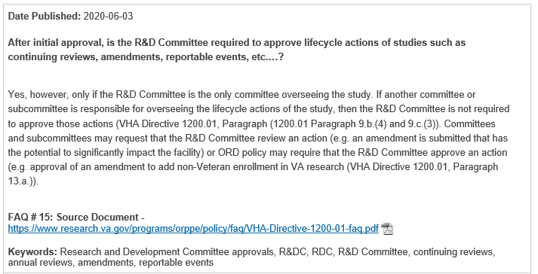
Key Words Associated with an FAQ: Example 1

Slide 16
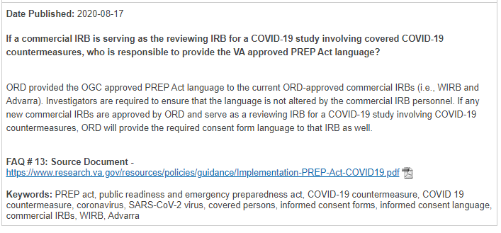
Key Words Associated with an FAQ: Example 2

Slide 17
Topics Covered in Searchable FAQ Database with >=10 entries
Animal Research (n=22)
Biosafety (n=27)
COVID-19 (n=92)
E-mail/Text Messages (n=23)
Information Security Platforms (n=10)
Informed Consent (n=13)
IRB Membership (n=10)
R&D Committee (n=23)
Transition to 2018-Rule (n=23)
VAIIRS (n=16)
Vulnerable Populations: (Pregnant Women and Children) (n=16)
See handout for complete list of topics included in the database.

Slide 18
Topics Covered in Searchable FAQ Database with =<5 entries
Amendments (n=4)
Certificates of Confidentiality (2)
Conflicts of Interest (3)
Continuing Reviews (5)
Non-Veterans (2)
Recruitment (2)
VA CIRB (3)
See handout for complete list of topics included in the database.

Slide 19
Topics not Currently Covered in Searchable FAQ Database
Biosafety (non-COVID)
Case Reports
Collaborative Research
Cooperative Research/Single IRB
Data
Devices
Expanded Access
FDA
Expedited Review
IRB Review
Merit Awards/Grants (non-Covid related)
Repositories
Publications
Record Control Schedule
Student/Trainee Research
Study Closures
Training (HSP Training Requirements)
Vulnerable Populations - Prisoners

Slide 20
Searchable FAQs: Example Searches
Question | Search Term(s) | # of Hits | Comments/Notes
What guidance is available on obtaining informed consent remotely? | Informed Consent | 32 | All FAQs tagged with informed consent (e.g. informed consent form, informed consent document, documentation of informed consent, etc.)
 | Remote Informed Consent | 16 | FAQs on Docusign, My HealtheVet, Azure RMS
 | Electronic Consent | 5 | FAQs on Docusign and iMed Consent
What guidance is available on use of combined ICF/HIPAA when the study involves banking? | Combined informed consent and HIPAA | 0 | Search phrase is not included as a key word in the database
 | combined ICF/HIPAA | 1 | Only FAQ on combined ICF and HIPAA Authorization forms.
 | Banking AND HIPAA | 2 | Includes one additional FAQ on signing HIPAA authorization forms.
 | HIPAA AND Informed Consent | 2 | Includes one additional FAQ on scanning ICFs and HIPAA forms.
Can email be used to recruit research subjects? | Email | 13 | All FAQs tagged with “email”. FAQs would have also been tagged with the key word “e-mail”.
 | Recruitment | 17 | Includes additional FAQs on recruitment of non-Veterans and advertising non-VA research.
 | Recruitment AND Email | 10 | Pulls up FAQs that have been tagged with both “recruitment” and “email”

Slide 21

Let’s Do Some Searches!

Slide 22

Questions

Slide 23
Resources
Resource | Link
ORD Policies and Guidance Webpage | https://www.research.va.gov/resources/policies/default.cfm
ORD Searchable FAQs | https://www.research.va.gov/resources/policies/faq-search.cfm
ORPP&E Webpage | https://www.research.va.gov/programs/orppe/default.cfm
ORPP&E Toolkits | https://www.research.va.gov/programs/orppe/education/tools.cfm
ORPP&E Webinars | https://www.research.va.gov/programs/orppe/education/webinars/default.cfm
ORPP&E Sample Templates | https://www.research.va.gov/programs/orppe/policy/draft/default.cfm
ORPP&E Single IRB Webpage | https://www.research.va.gov/programs/orppe/single_irb.cfm
ORPP&E VAIIRS Webpage | https://www.research.va.gov/programs/orppe/vairrs/default.cfm
ORPP&E Mailboxes | See slide 8
VHA Publications | https://www.va.gov/vhapublications/

Slide 24
Availability of Recording
A recording of this session and the associated handouts will be available on ORPP&E’s Education and Training website approximately one-week post-webinar
An archive of all ORPP&E-hosted webinars can be found here: https://www.research.va.gov/programs/orppe/education/webinars/archives.cfm

Slide 25
Contact Information
Soundia Duche, MA, MS
Director, Education and Training
Office of Research, Protections, Policy, and Education
Office of Research and Development
E-mail: Soundia.Duche@va.gov

